Slide 1
CSM104: Analog and Digital Electronics
YEAR 1
LECTURER: Dr. Alfred UWITONZE
CONTACTS: Phone number: 0788549588
E-mail: alfruwitonze@gmail.com
Academic Year 2022-2023

Slide 2
GRADING
CAT 1 (3 Assignements): 30%
CAT 2: 30%
FAT: 40%

Slide 3
UNIT 2: ANALOG ELECTRONICS
SEMICONDUCTOR DEVICES
Semiconductors are materials which are neither conductors or insulators, having conductivities intermediate to those of conductors like copper and insulators like wood or plastic.
Common semiconductors are Silicon and Germanium.
The reason semiconductors are important is that with some engineering they can sometimes both conduct and insulate depending on their connections.
Thus, they serve as the basis for switching and amplification, the fundamental actions of computer elements.

Slide 4
UNIT 2: ANALOG ELECTRONICS
SEMICONDUCTOR DEVICES
A typical modern processor has several million transistors, one of the elements manufactured from semiconducting material which we will study here.
There are two main types of semiconductor materials:
Intrinsic - where the semiconducting properties of the material occur naturally i.e. they are intrinsic to the material's nature.
extrinsic - the semiconducting properties of the material are manufactured, by us, to make the material behave in the manner which we require.

Slide 5
UNIT 2: ANALOG ELECTRONICS
SEMICONDUCTOR DEVICES
Nearly all the semiconductors used in modern electronics are extrinsic.
This means that they have been created by altering the electronic properties of the material.
The two most common methods of modifying the electronic properties are:
Doping - the addition of 'foreign' atoms to the material.
The two classes of doping are p-type and n-type which refer to the introduction of positive and negative charge carriers.

Slide 6
UNIT 2: ANALOG ELECTRONICS
TRANSISTORS
A transistor is a semiconductor device used to amplify the electronic signals.
It is made up of three layers of semiconductor material: a thin layer of either P-type (positively charged) or N-type (negatively charged) material sandwiched between two layers of the opposite type.
The three layers are known as the emitter, base, and collector.
By controlling the flow of current between the base and the emitter, a small input current can be used to control a much larger output current between the collector and emitter.

Slide 7
UNIT 2: ANALOG ELECTRONICS
TRANSISTORS
Transistors are fundamental building blocks of modern electronic devices and are used in a wide range of applications, including amplifiers, switches, oscillators, and digital logic circuits.

Slide 8
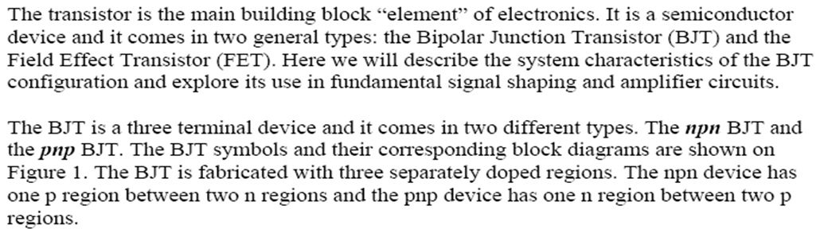
UNIT 2: ANALOG ELECTRONICS
TRANSISTORS

Slide 9
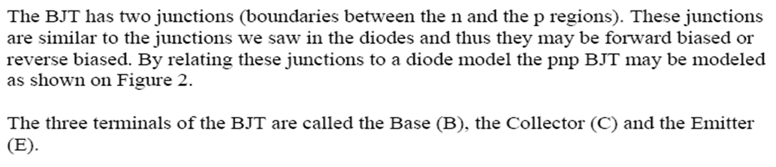
UNIT 2: ANALOG ELECTRONICS
TRANSISTORS

Slide 10
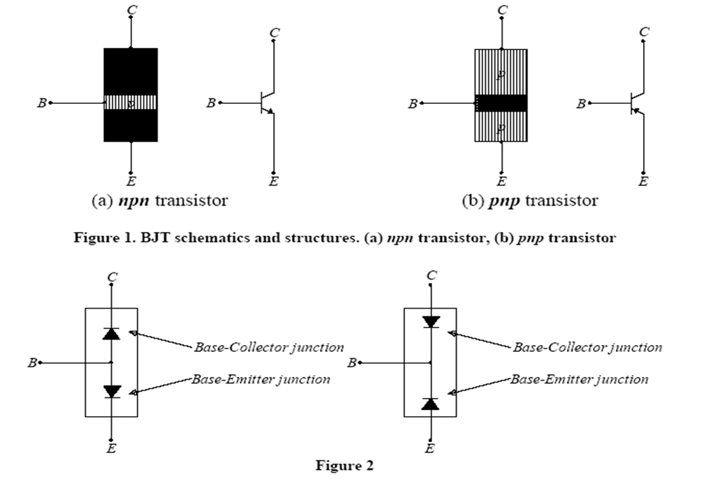
UNIT 2: ANALOG ELECTRONICS
TRANSISTORS

Slide 11
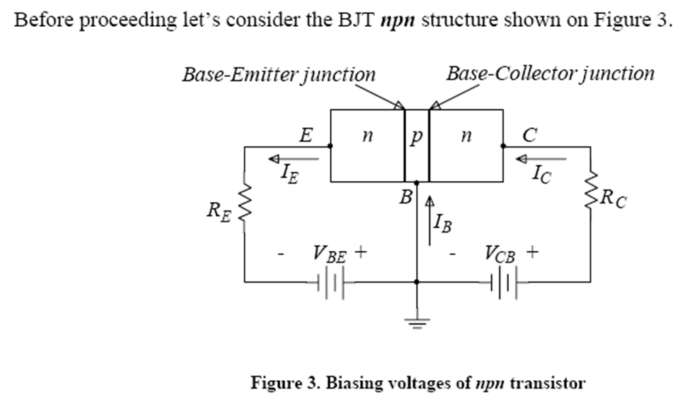
UNIT 2: ANALOG ELECTRONICS
TRANSISTORS

Slide 12
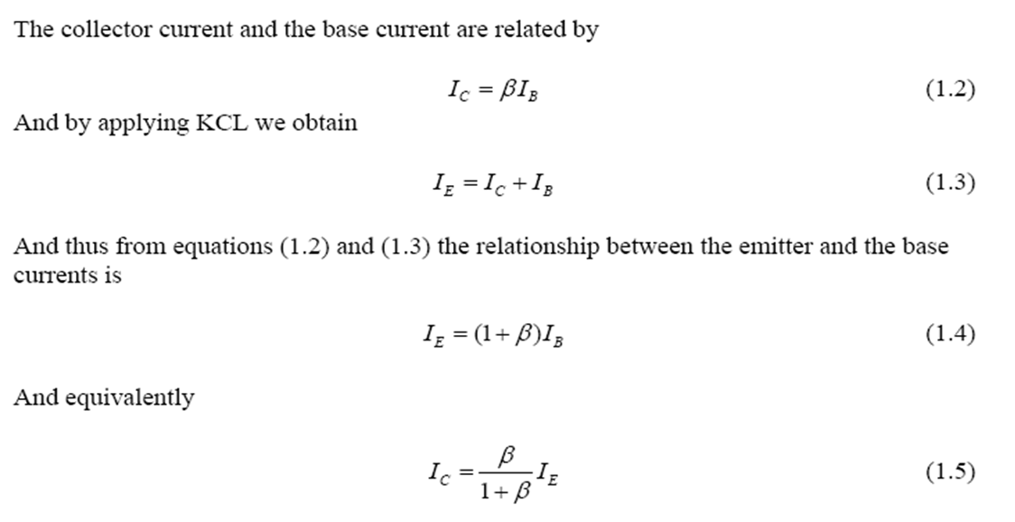
UNIT 2: ANALOG ELECTRONICS
TRANSISTORS

Slide 13
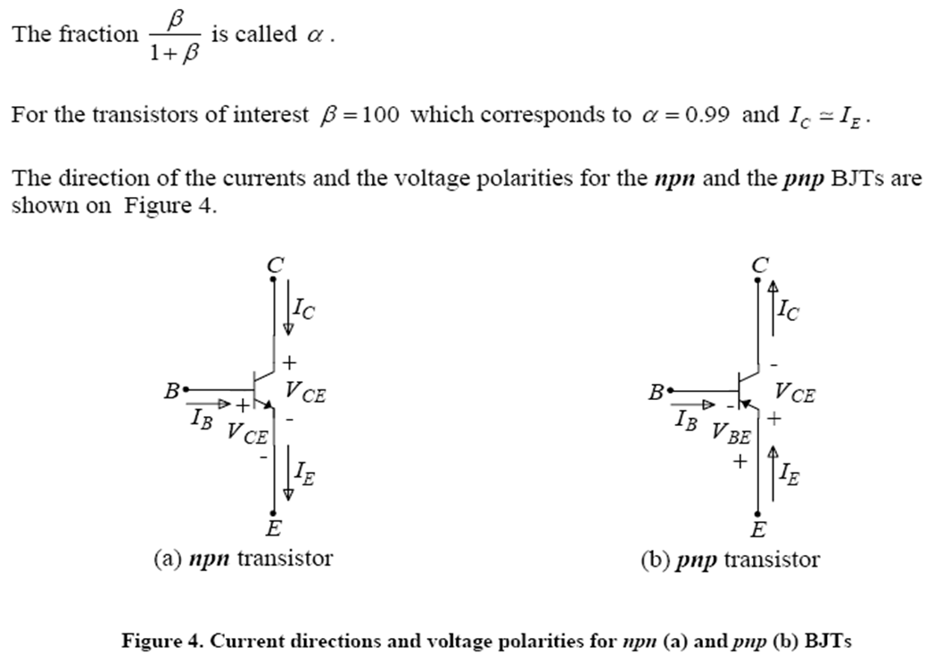
UNIT 2: ANALOG ELECTRONICS
TRANSISTORS

Slide 14
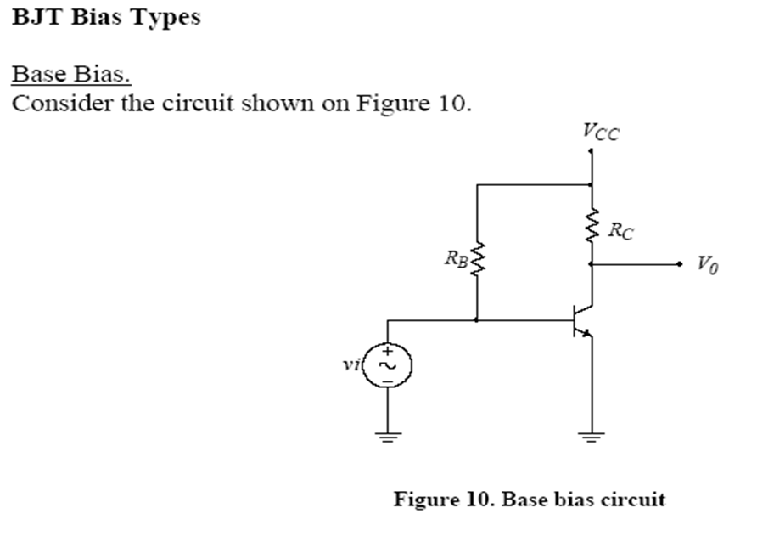
UNIT 2: ANALOG ELECTRONICS
TRANSISTORS

Slide 15
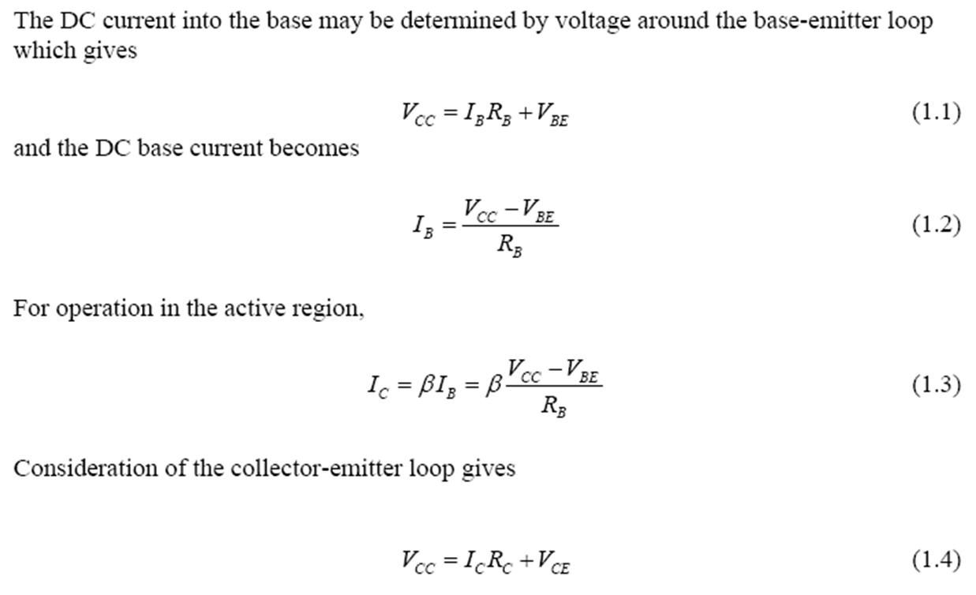
UNIT 2: ANALOG ELECTRONICS
TRANSISTORS

Slide 16
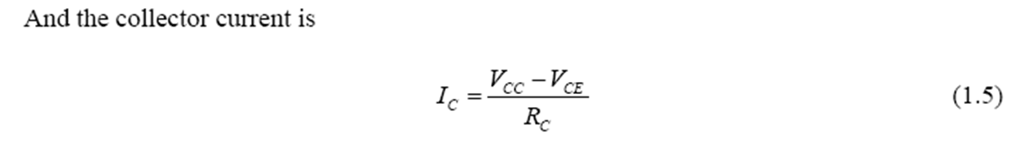
UNIT 2: ANALOG ELECTRONICS
TRANSISTORS

Slide 17
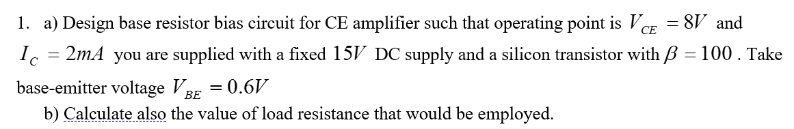
UNIT 2: ANALOG ELECTRONICS
TRANSISTORS
Example 1:

Slide 18
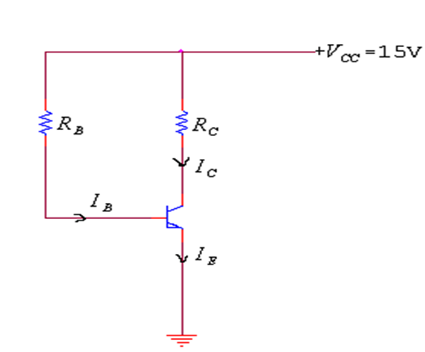
UNIT 2: ANALOG ELECTRONICS
TRANSISTORS
Example 1:

Slide 19
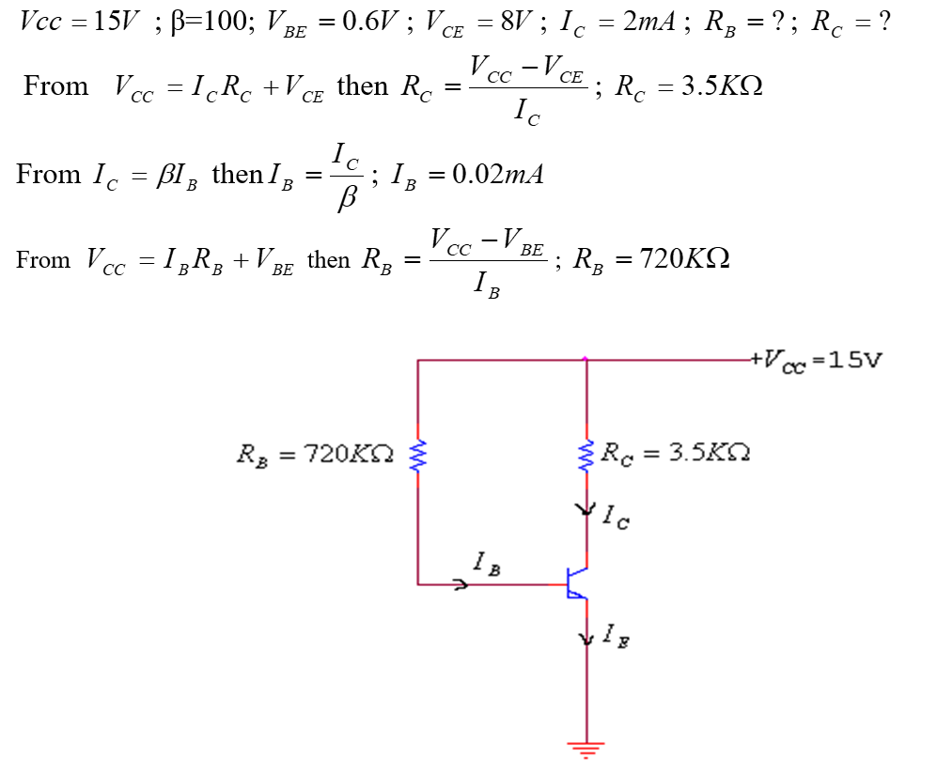
UNIT 2: ANALOG ELECTRONICS
TRANSISTORS
Solution:

Slide 20
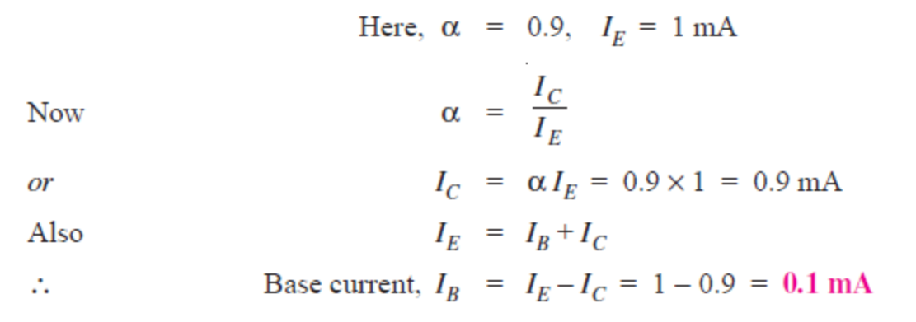
UNIT 2: ANALOG ELECTRONICS
TRANSISTORS
Example 2:
In a common base connection, current amplification factor is 0.9. If the emitter current is 1mA, determine the value of base current.
Solution:

Slide 21
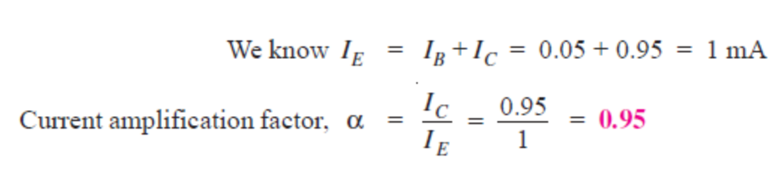
UNIT 2: ANALOG ELECTRONICS
TRANSISTORS
Example 3:
In a common base connection, IC = 0.95 mA and IB = 0.05 mA. Find the value of α.
Solution:

Slide 22
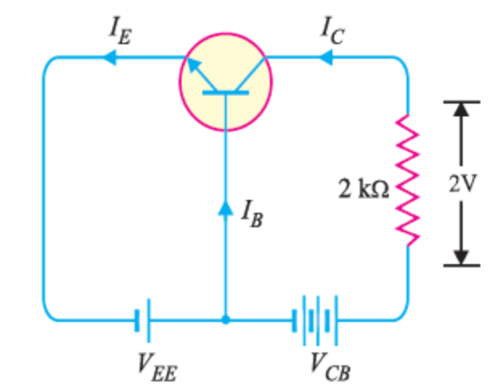
UNIT 2: ANALOG ELECTRONICS
TRANSISTORS
Example 4:
In a common base connection circuit shown below, α = 0.95. The voltage drop across 2 kΩ resistance which is connected in the collector is 2V. Find the base current.

Slide 23
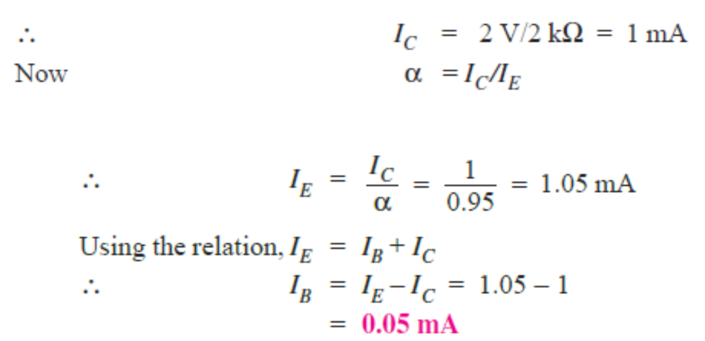
UNIT 2: ANALOG ELECTRONICS
TRANSISTORS
Solution:

Slide 24
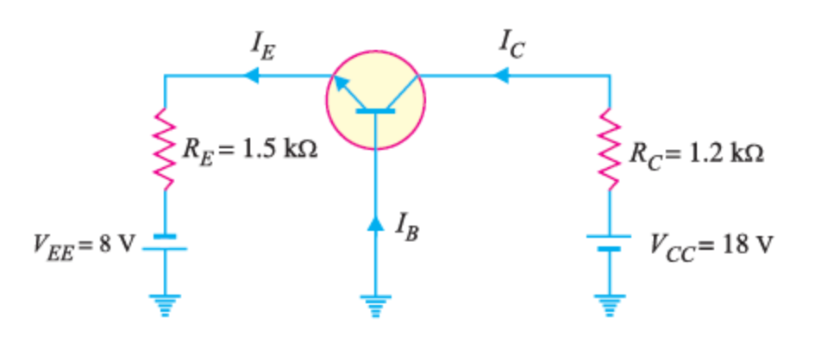
UNIT 2: ANALOG ELECTRONICS
TRANSISTORS
Example 5:
For the common base circuit shown in Figure below, determine IC and VCB . Assume the transistor to be of silicon.

Slide 25
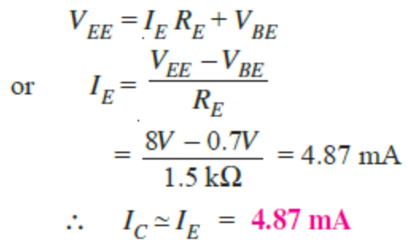
UNIT 2: ANALOG ELECTRONICS
TRANSISTORS
Solution:
Since the transistor is of silicon, VBE = 0.7V.
Applying Kirchhoff’s voltage law to the emitter-side loop, we get,

Slide 26
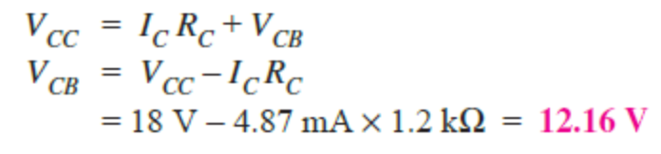
UNIT 2: ANALOG ELECTRONICS
TRANSISTORS
Solution:
Applying Kirchhoff’s voltage law to the collector-side loop, we have,

Slide 27
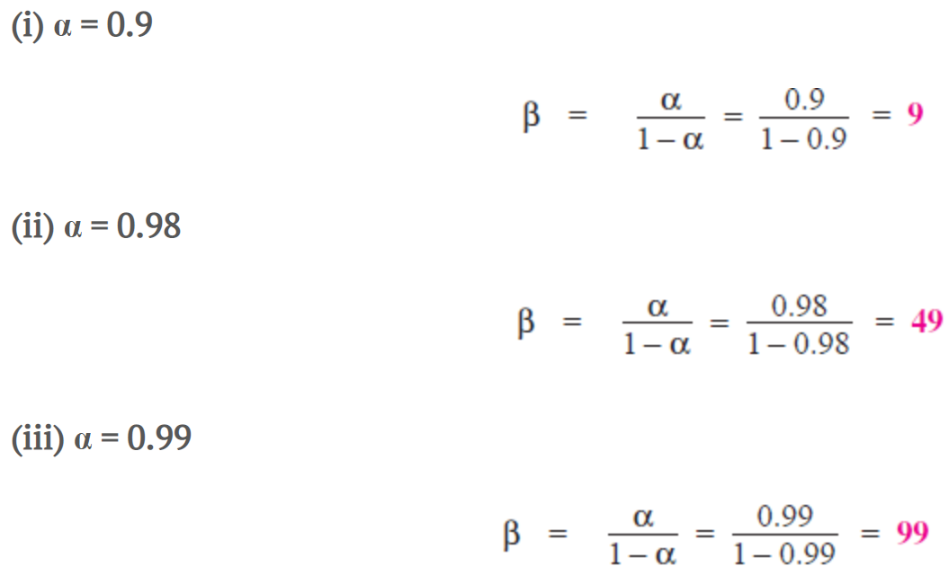
UNIT 2: ANALOG ELECTRONICS
TRANSISTORS
Example 6:
Find the value of β if (i) α = 0.9 (ii) α = 0.98 (iii) α = 0.99.
Solution:

Slide 28
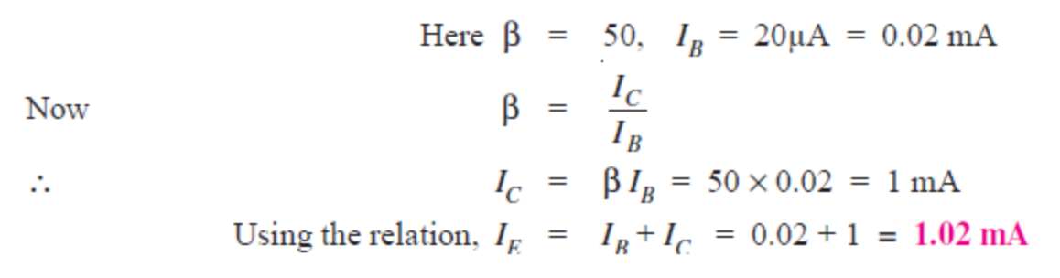
UNIT 2: ANALOG ELECTRONICS
TRANSISTORS
Example 7:
Calculate IE in a transistor for which β = 50 and IB = 20 μA.
Solution:

Slide 29
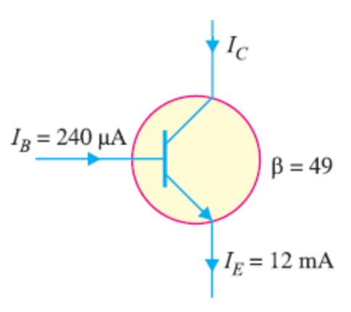
UNIT 2: ANALOG ELECTRONICS
TRANSISTORS
Example 8:
Find the α rating of the transistor shown in Figure below. Hence determine the value of IC using both α and β rating of the transistor.

Slide 30
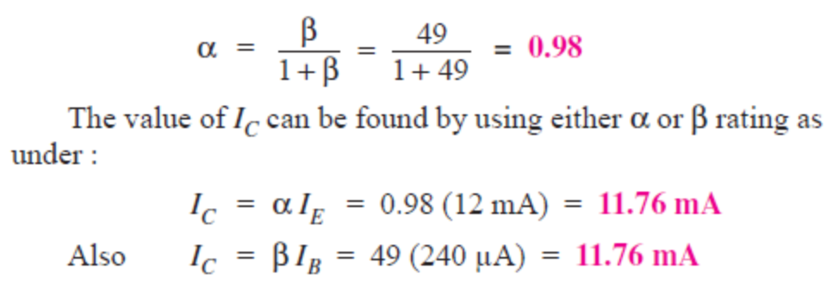
UNIT 2: ANALOG ELECTRONICS
TRANSISTORS
Solution:

Slide 31
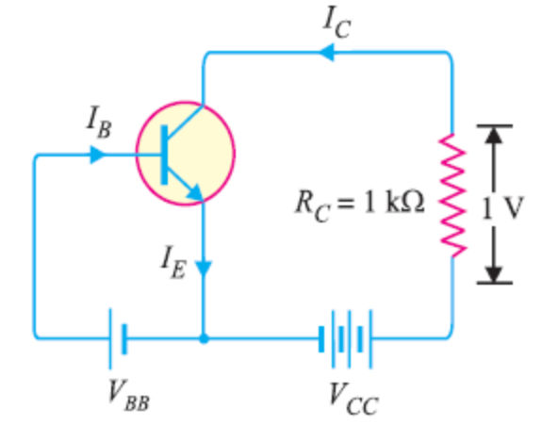
UNIT 2: ANALOG ELECTRONICS
TRANSISTORS
Example 9:
For a transistor, β = 45 and voltage drop across 1kΩ which is connected in the collector circuit as shown in Figure below is 1 volt. Find the base current for common emitter connection.

Slide 32
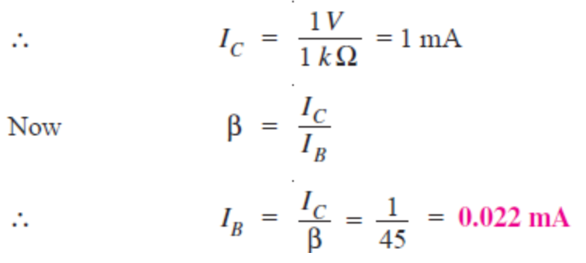
UNIT 2: ANALOG ELECTRONICS
TRANSISTORS
Solution:

Slide 33
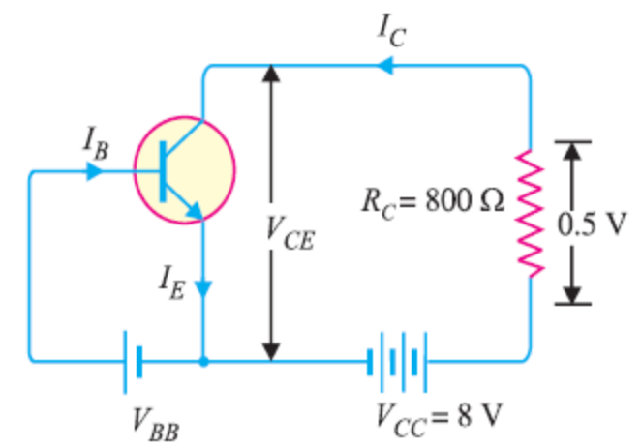
UNIT 2: ANALOG ELECTRONICS
TRANSISTORS
Example 10:
A transistor is connected in common emitter (CE) configuration in which collector supply is 8 V and the voltage drop across resistance RC connected in the collector circuit is 0.5 V. The value of RC = 800 Ω. If α = 0.96, determine : (i) collector-emitter voltage (ii) base current.

Slide 34
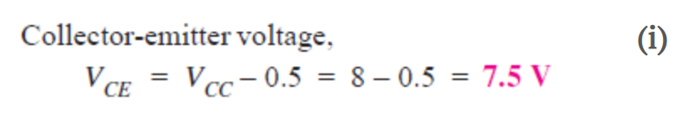
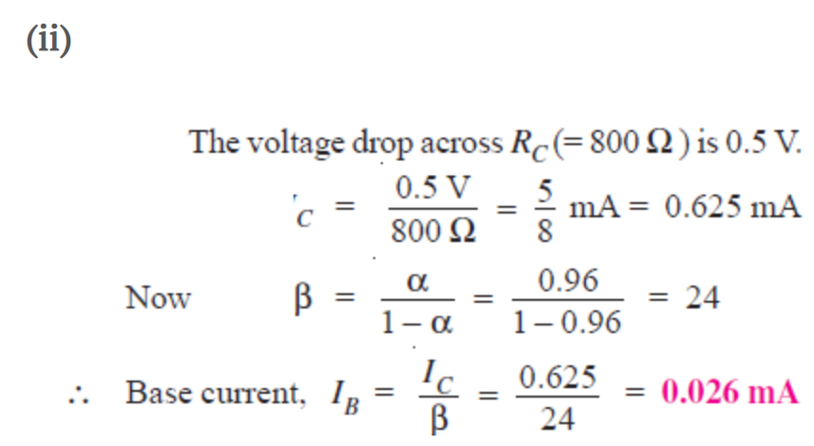
UNIT 2: ANALOG ELECTRONICS
TRANSISTORS
Solution:

